Slide 1



TimeSheets:
Threat Report
Rawan Amr Abdelsattar
DATE

Slide 2

How to use this Template
Make a copy of this Google Slide deck.
We have provided these slides as a guide to ensure that you submit all the required components to successfully complete your project.
When presenting your project, please only think of this as a guide. We encouraged you to use creative freedom when making changes as long as the required information is present.
Remember to delete this and all of the other example slides before you submit your project.
Remember to add your name and the date to the cover slide
Remove this slide

Slide 3
Purpose of this Report:
This is a threat model report for TimeSheets. The report will describe the threats facing TimeSheets. The model will cover the following:
Threat Assessment
Scoping out Asset Inventory
Architecture Audit
Threat Model Diagram
Threats to the Organization
Identifying Threat Actors
Vulnerability Analysis
Risk Analysis
Mitigation Plan
Remove this slide

Slide 4
Section 1
Initial Threat Assessment

Slide 5
Completed Asset Inventory
Components and Functions
TimeSheets Web Server: The web server's primary role is to serve static content to a requesting client through the http protocol.
TimeSheets Application Server: The application server handles all the business logic process and serves dynamic content.
TimeSheetsDB: The database server stores employee data and will be queried from the application server.
AuthDB: Stores user authentication data (credentials) and will be queried from the application server.
Remove this slide

Slide 6
Completed Asset Inventory
Overview of Application Functionality
TimeSheets is used by employees to track their hours worked. Users will login to the TimeSheets application from their device.
Data Flow
Request is generated from the client via the Internet. The request arrives at the TimeSheets web server which serves static content to the user (HTML, images, etc). Dynamic data is retrieved from the database and served to the client.

Slide 7
Completed Architecture Audit
Flaws
There is a lack of encryption at rest - database servers are storing data on unencrypted disks.
There is lack of redundancy.
There is no firewall that is filtering traffic coming from the Internet

Slide 8
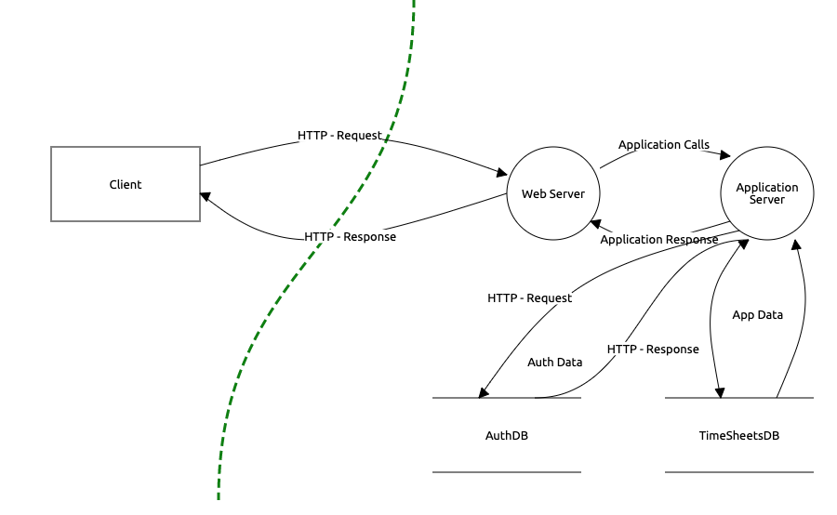
Completed Threat Model
Employee Data Unencrypted at Rest
Authentication data is using reversible encryption
Authentication requests are not encrypted in transit
Sensitive data is encrypted using DES algorithm

Slide 9
Completed Threat Analysis
What Type of Attack Caused the Login Alerts?
Man in the Middle (MitM)
What Proves Your Theory?
There is lack of encryption between the client and the application. A malicious actor is sniffing traffic and intercepting the requests with a valid username/password in the request. Additionally, the logs show successful login attempts from the expected IP, but also a different location at the same time.

Slide 10
Completed Threat Actor Analysis
Who is the Most Likely Threat Actor?
Internal User
What Proves Your Theory?
The IP address of the unexpected login matches that of an internal user. Additionally, there was no data leaked from the company, and no data changed. Just data accessed that the legitimate user typically doesn’t access.

Slide 11
Section 2
Vulnerability Analysis

Slide 12
2.1 Employee Data Unencrypted at Rest
Discovery:
During the threat model the SRE team confirmed that the database is on a server that does not have encryption at rest.
Why is this an issue?
Not encrypting database on the server at rest poses a great security risk to the company, including:
Risk of unauthorized access: as it threatens the confidentiality and the integrity of the data in case of a breach/ data leak posing threats like information disclosure and tampering (according to the STRIDE model).
Regulatory Compliance issues: most regulations mandate encrypting database data at rest. Non-compliance with those regulations can cause financial penalties or lead to legal consequences.
Data theft/manipulation: non-encrypted database data could be stolen and/or tampered with.

Slide 13
2.2 Authentication Data Stored Using Reversible Encryption
Discovery:
During the threat model the DBA team confirmed that the database is storing authentication data (credentials) encrypted.
Why is this an issue?
Storing authentication data in that way means that it can be decrypted.
This is a big security issue, as a knowledgeable attacker can reverse the encryption of (decrypt) the authentication data potentially leading to:
Identity theft: successfully managing to access credentials of employees can lead to identity theft posing a security risk as a result of threats like spoofing and repudiation (in terms of STRIDE model)
Escalation of privilege: having breached a system and accessed authentication data can enable the attacker to further try to attack other systems/applications within the network exploiting those credentials in various ways.

Slide 14
2.3 Authentication Requests are Unencrypted in Transit
Discovery:
During the threat model the security team confirmed that authentication requests are being transmitted in plaintext.
Why is this an issue?
According to NIST SP 800-123 standard regarding general server security : "Sensitive information transmitted unencrypted or weakly encrypted between the server and the client may be intercepted." and this is because of the likelihood of attacks like man-in-the-middle and spoofing attacks where the attacker can intercept the communications and sniff packets violating confidentiality and integrity of data in transit.
These intercepted authentication data can lead to identity theft and/or escalation of privilege as mentioned earlier.
Also, according to the MITRE corporation, this is considered a weakness as in "CWE-319: Cleartext Transmission of Sensitive Information" with a likelihood of exploit of "high" and a scope of "Integrity" and "Confidentiality" and an impact of "Anyone can read the information by gaining access to the channel being used for communication".

Slide 15
2.DES Algorithm in Use
Discovery:
During the threat model the security team identified sensitive data being stored using the DES algorithm.
Why is this an issue?
Key Length: DES has a relatively short key length of 56 bits, making it vulnerable to brute-force attacks
Vulnerable Algorithm Design: DES has been shown to have vulnerabilities to various cryptographic attacks, including differential cryptanalysis and linear cryptanalysis, which can exploit weaknesses in the algorithm's design.
Standardization Issues: DES is a standardized encryption algorithm, but concerns have been raised regarding the National Security Agency's involvement in its development, leading to suspicions about potential backdoors or weaknesses intentionally introduced into the algorithm.
Furthermore, on June 02, 2005, on the news page of NIST official website it said, "Adopted in 1977 for federal agencies to use in protecting sensitive, unclassified information, the DES is being withdrawn because it no longer provides the security that is needed to protect federal government information."

Slide 16
Optional Task:
Examine the threat model diagram from Section 1 and answer:
What non-encryption issues can you identify?
What recommendation would you give to solve those issues?
Why do you recommend those solutions?
[Issue 1 Here]
[Issue 2 Here]
[Add more issues as necessary]

Slide 17
Section 3
Risk Analysis

Slide 18
3.1 Scoring Risks
Risk | Score (1 is most dangerous, 4 is least dangerous)
Unencrypted at Rest
Reversible Encryption
Unencrypted in Transit
Outdated Algorithm
Remove this slide

Slide 19
3.2 Risk Rationale
Why Did You Choose That Ranking? Make sure to include your risk ranking methodology. (Did you use a tool or defined risk scoring system?)

Slide 20
Section 4
Mitigation Plan

Slide 21
4.1 Employee Data Unencrypted at Rest
What is Your Recommended Mitigation Plan?
[Your recommended plan here]
Why Did you Recommend This Course of Action?
[Your justification here]
Look NIST 800-123 p.31

Slide 22
4.2 Authentication Data Stored Using Reversible Encryption
What is Your Recommended Mitigation Plan?
[Your recommended plan here]
Why Did you Recommend This Course of Action?
[Your justification here]

Slide 23
4.3 Authentication Requests are Not Encrypted in Transit
What is Your Recommended Mitigation Plan?
[Your recommended plan here]
Why Did you Recommend This Course of Action?
[Your justification here]
Look NIST 800-123 p.30, p.48

Slide 24
4.4 DES Algorithm in Use
What is Your Recommended Mitigation Plan?
[Your recommended plan here]
Why Did you Recommend This Course of Action?
[Your justification here]

Slide 25
4.5 Security Audit
The audit team has been made aware of the systemic issue and wants to ensure your recommendations are followed. What steps can the audit team take?
[Your answer here]

Slide 26
Optional Task:
Create an architecture diagram of a secure system.
Image of your secure architecture:

Slide 27
Optional Task (Continued):
Additional Steps Would You Recommend to Prevent the Attack as well as Future Issues:

